Slide 1
JAC
Contact-Me

Slide 2
Our Proposal
Refresher of Website
Stakeholders
Functional and Non-functional requirements
Technologies We Intend to Use

Slide 3
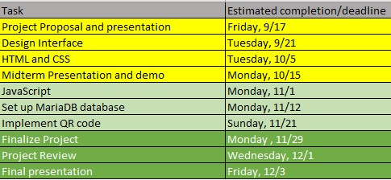
Schedule

Slide 4
Pages We Created

Slide 5
AJAX Header and footer
Sitewide style.css
Separation of concerns
Easy to change in one place

Slide 6
Groups page
Includes an unordered list of groups you are a part of
If access to an admin account, can create/edit groups

Slide 7
Create Groups Page
Edit created groups or create new
Options enabled through JS and backend soon...
QR code here in the future

Slide 8
Individual groups page
Groups page → here
See more information on group
See attendees of group (view their profiles)

Slide 9
Home page
Gives a description of Contact Me
About JAC

Slide 10
Sign up
Sign up to make a profile
Matches login

Slide 11
Log In
-Account to have access to their profile
-Unique purple background
-Own CSS

Slide 12
Profile Page (editable)
-Make changes (name, last name, social media)
-Save changes
-Unique purple background
-Own CSS

Slide 13
Profile page (viewable)
-Profile picture, name, last name, social media
-Unique purple background
-Own CSS

Slide 14
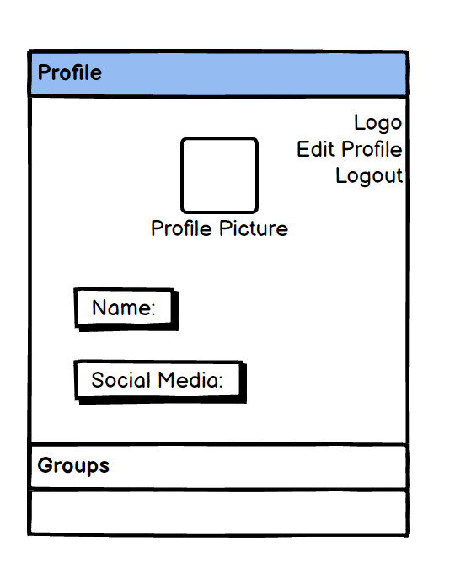
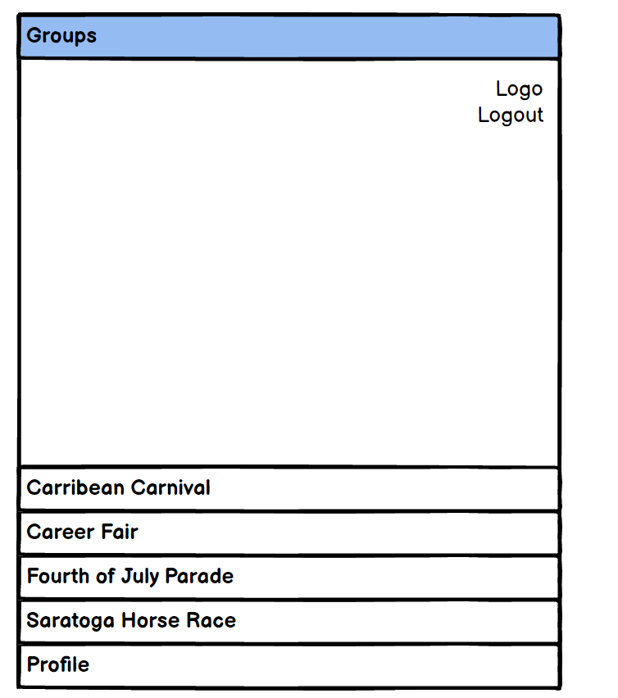
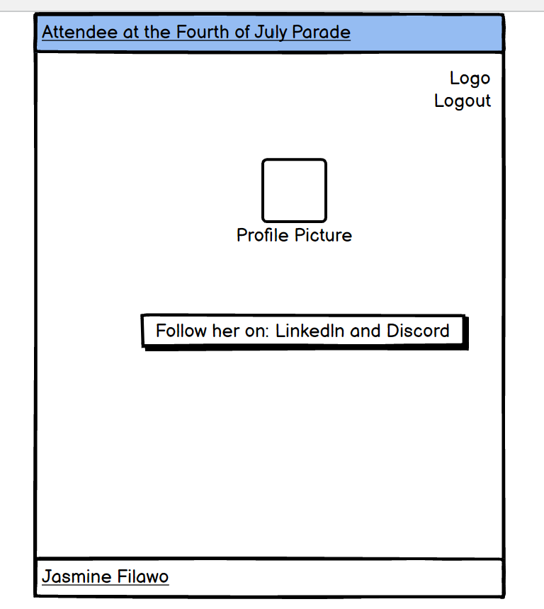
Balsamiq

Slide 15
Demo of the Website

Slide 16
Q&A

